Slide 1

Kopi Kompleks Branch Expansion
July 2020

Slide 2
PROBLEM FORMULATION
The franchise in question, Kopi Kompleks, has already opened 4 branches across Surabaya.
The franchise is looking to open their fifth one. It could potentially be unbeneficial for the franchise to expand into the wrong neighborhood.

Slide 3
DATA SOURCING
The following data were sourced and cleaned:
Foursquare API Data
Population Density Data
Surabaya Geospatial Data
Obtained automatically using the application’s API call;
Returns the number of cafe/coffee shops and their location in every neighborhood.
Sourced from Surabaya’s Central of Statistics;
Returns population density of each neighborhood (kelurahan) in Surabaya;
Took out the existing branches’ four neighborhoods from the dataset;
Cleaned missing values.
Sourced from an open-source ArcGIS Online item;
Returns longitude and latitude values of each neighborhood in Surabaya, in .shp file format;
.shp file format was then converted into both .geojson and .csv file format.
Dropped some unrepresentative columns in the .csv file

Slide 4
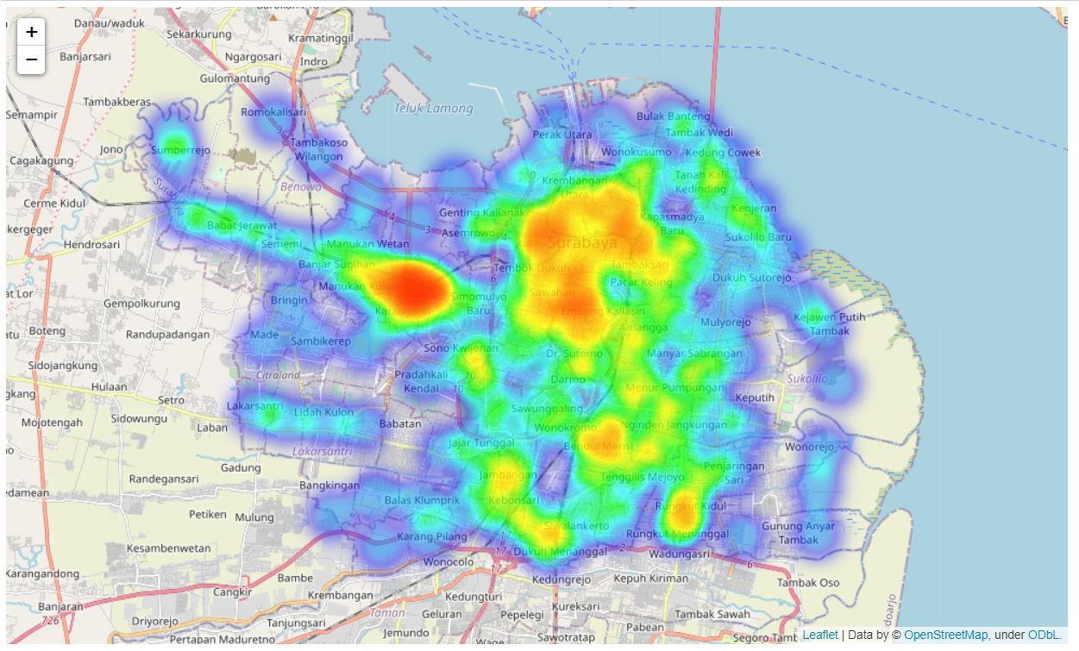
DATA VISUALIZATION
Population density is visualized as this heatmap:

Slide 5
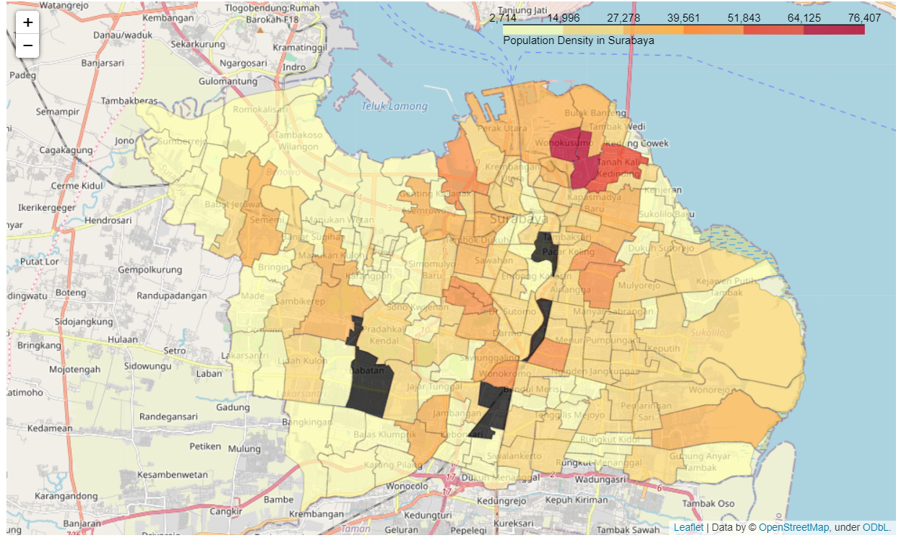
DATA VISUALIZATION
Population density is also visualized in this choropleth. The four greyed segments are the neighborhoods we took out from the dataset.

Slide 6
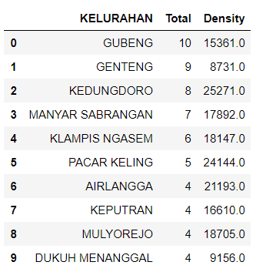
DATA PREPROCESSING
The following steps were taken:
Merging the population data with the Foursquare venue data;
A preview of the merged dataset is displayed on the right
Applying z-score normalization for both venue count feature and population density feature.
Gubeng has the most coffee shops in the area. This is justified because Gubeng is one of the nearest neighborhoods to the city center. It’s also relatively near to Airlangga University and Sepuluh Nopember Institute of Technology, two of Surabaya’s biggest universities.

Slide 7
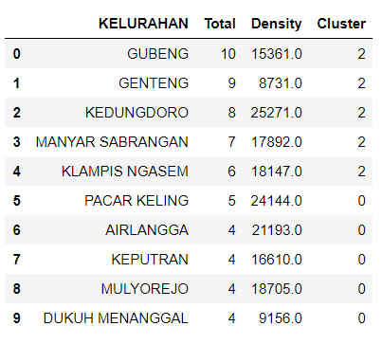
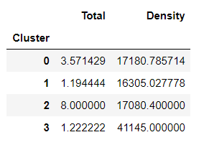
CLUSTERING RESULTS
Segmented neighborhoods into four different clusters
Figure A
Figure B
Results:
Assigned all neighborhoods based on cluster labels, as seen on Figure A
Grouping each cluster based on the mean of total coffee shops and population density, seen on Figure B

Slide 8
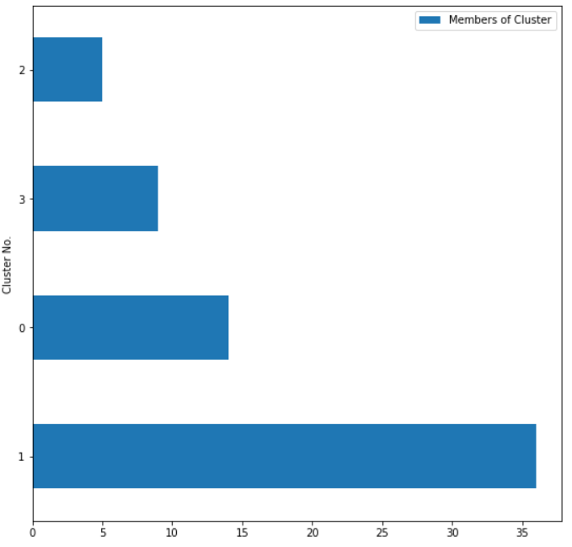
CLUSTERING RESULTS
Segmented neighborhoods into four different clusters
Results:
Visualizing the amount of members in each cluster, as seen in Figure C.
We can see that cluster no. 1 has the most members, while cluster no. 2 has the least members.
Figure C

Slide 9
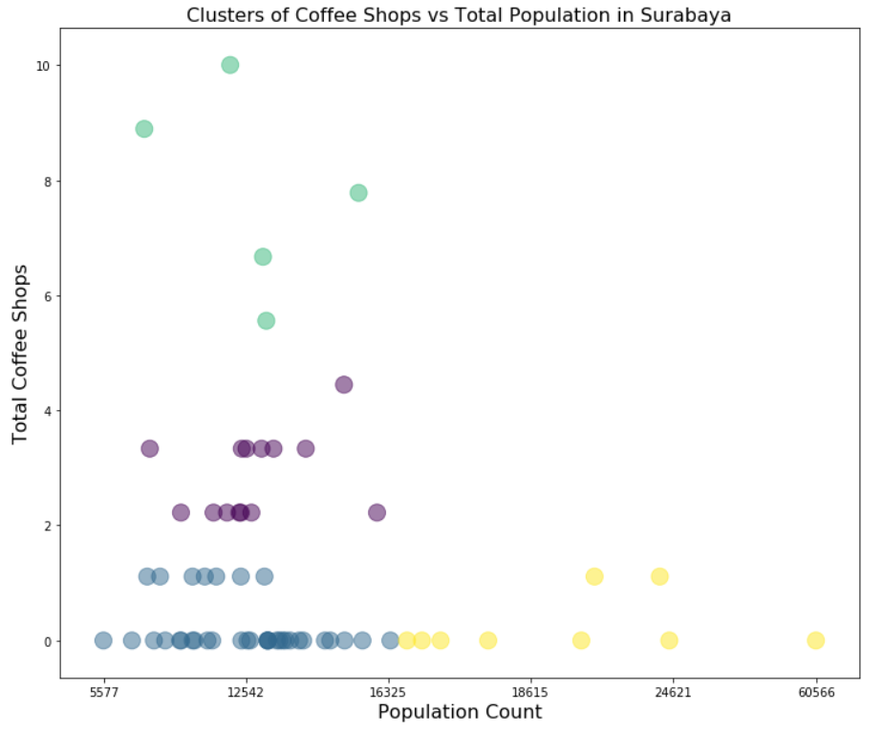
CLUSTERING RESULTS
Segmented neighborhoods into four different clusters
Results:
Analyzing the distribution of neighborhood segmentation based on total coffee shops in the area and its population density, seen in Figure D.
Figure D

Slide 10
CLUSTER RELABELING
Draw insights from existing clusters and assign clearer names
Looking through the scatter plot visualization, label each of our clusters:
Cluster 3 has the second-to-least members, a few coffee shops, with the most densely-populated neighborhoods. Fewer coffee shops mean fewer competition. We can say that this is indeed the most prospective cluster.
Cluster 0 has a moderate amount of members, with each having a relatively high number of total coffee shops. This is therefore the mid-highly prospective cluster.
Cluster 1 has the most members, alongside a few coffee shops in each. With the lower half of population density belonging to this cluster, this area is the moderately prospective cluster.
Cluster 2 has the fewest members, but also the most amount of total coffee shops. More coffee shops mean more competition. This area is the least prospective cluster.

Slide 11
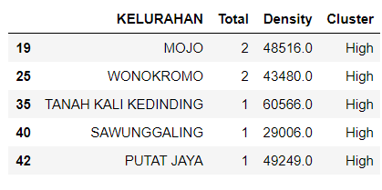
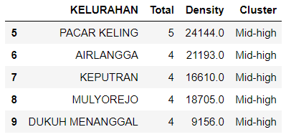
FINAL RESULTS
Displaying the characteristics for each cluster:
Most Prospective Areas
Moderate-to-high Prospective Areas
Displaying five of the most prospective neighborhoods; high density and low competition:
Displaying five of the moderate-to-high prospective neighborhoods; average density and average competition:

Slide 12
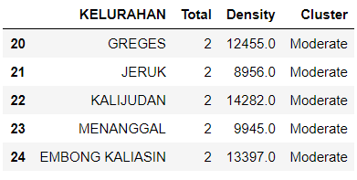
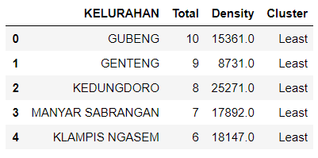
FINAL RESULTS
Displaying the characteristics for each cluster:
Moderately Prospective Areas
Least Prospective Areas
Displaying five of the moderately prospective neighborhoods; average density and low competition:
Displaying five of the least prospective neighborhoods; low density and very high competition:

Slide 13
CONCLUSION
Suggestions for future modeling include:
More continuous feature sets may be needed to reinforce the model further.
For example, average lot price per square meters, traffic density, or Level of Service (LOS) might be a good predictor for the unsupervised model to perform better.

Slide 14
THANK YOU!
Charis Chrisna C
Email:
charischrisna3@gmail.com
Portfolio:
http://notpestilence.github.io

